Slide 1
SHA256
Secure Hash Algorithm

Slide 2
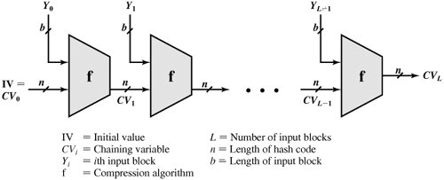
SHA-256 produces a hash value of 256 bits.
The input is processed in 512-bit blocks.
Figure 1. Message Digest Generation Using SHA-256. Source: Cryptography and Network Security by William Stallings.

Slide 3
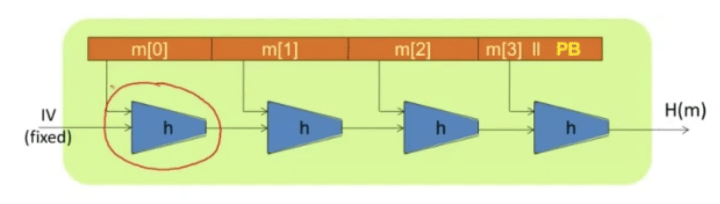
What is the Merkle-Damgard Paradigm?
Given a collision resistant hash function for short messages we can construct collision resistant hash function for long messages.
Figure 2. Merkle-Damgard Paradigm

Slide 4
The hash algorithm involves repeated use of a compression function, f, that takes two inputs (an n-bit input from the previous step, called the chaining variable, and a b-bit block) and produces an n-bit output.
At the start of hashing, the chaining variable has an initial value that is specified as part of the algorithm.
The final value of the chaining variable is the hash value. Often, b > n; hence the term compression.

Slide 5
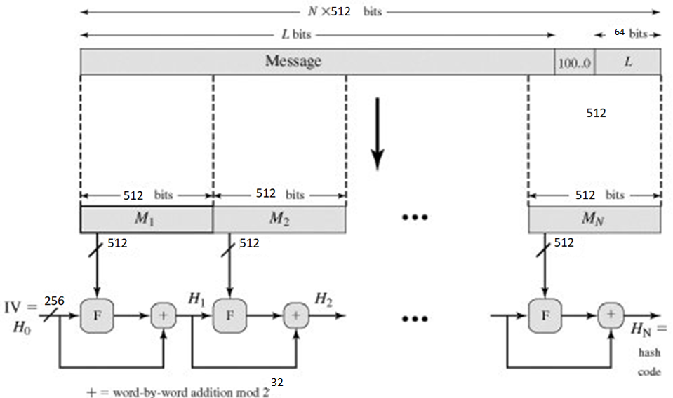
Figure 3. Message Digest Generation Using SHA-256. Source: Cryptography and Network Security by William Stallings
.

Slide 6
The processing consists of the following steps:
Step 1: Append padding bits.
The message is padded so that its length is congruent to 448 modulo 512 [x modulo 512 and 448 modulo 512 is the same number].
Padding is always added, even if the message is already of the desired length. Thus, the number of padding bits is in the range of 1 to 448.
The padding consists of a single 1-bit followed by the necessary number of 0-bits.
Step 2: Append length.
A block of 64 bits is appended to the message and contains the length of the original message.
The outcome of the first two steps yields a message that is an integer multiple of 512 bits in length.
In the figure, the expanded message is represented as the sequence of 512-bit blocks M₁, M₂,..., M_{N}, so that the total length of the expanded message is N x 512 bits.

Slide 7
Step 3: Initialize hash buffer. A 256-bit buffer is used to hold intermediate and final results of the hash function. The buffer can be represented as eight 32-bit registers (a, b, c, d, e, f, g, h).
Step 4: Process message in 512-bit blocks. The heart of the algorithm is a module that consists of 64 rounds; this module is labeled F in Figure 3. The logic is illustrated in Figure 4.

Slide 8
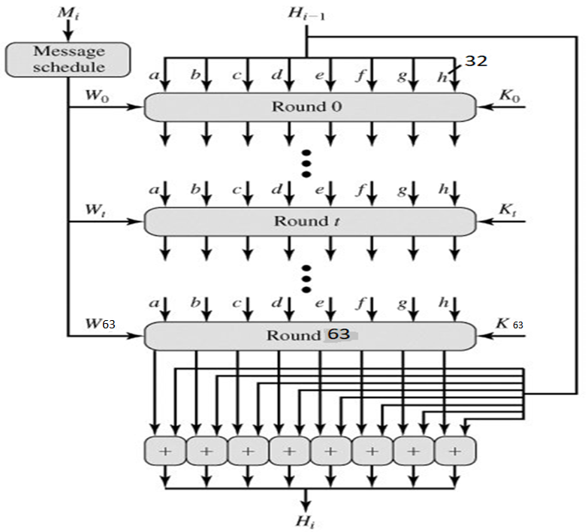
Figure 4. The compression function used in SHA-256. Source: Cryptography and Network Security by William Stallings

Slide 9
Each round takes as input the 256-bit buffer value abcdefgh, and updates the contents of the buffer.
At input to the first round, the buffer has the value of the intermediate hash value, H_{i-1}.
Each round t makes use of a 32-bit value W_{t} derived from the current 512-bit block being processed (M_{i}) These values are derived using a message schedule described subsequently.
Each round also makes use of an additive constant K_{t} where 0<= t<= 63 indicates one of the 64rounds.

Slide 10
These constants represent the first 32 bits of the fractional parts of the cube roots of the first 64 prime numbers. The constants provide a "randomized" set of 32-bit patterns, which should eliminate any regularities in the input data.
The output of the 63 round is added to the input to the first round (H_{i-1})to produce H_{i}. The addition is done independently for each of the eight words in the buffer with each of the corresponding words in H_{i-1}.
Step 5: Output. After all N 512-bit blocks have been processed, the output from the Nth stage is the 256-bit message digest.

Slide 11
Each round of the 64 rounds is defined by the following set of equations:
break message into 512-bit chunks
for each chunk create a 64-entry message schedule array w[0..63] of 32-bit words
(The initial values in w[0..63] don't matter, so many implementations zero them here)
copy chunk into first 16 words w[0..15] of the message schedule array
Extend the first 16 words into the remaining 48 words w[16..63] of the message schedule array:
for i from 16 to 63
s0 := (w[i-15] rightrotate 7) xor (w[i-15] rightrotate 18) xor (w[i-15] rightshift 3)
s1 := (w[i-2] rightrotate 17) xor (w[i-2] rightrotate 19) xor (w[i-2] rightshift 10)
w[i] := w[i-16] + s0 + w[i-7] + s1
Initialize working variables to current hash value:
a := h0 b := h1 c := h2 d := h3 e := h4 f := h5 g := h6 h := h7

Slide 12
Compression function main loop:
for i from 0 to 63
S1 := (e rightrotate 6) xor (e rightrotate 11) xor (e rightrotate 25)
ch := (e and f) xor ((not e) and g)
temp1 := h + S1 + ch + k[i] + w[i]
S0 := (a rightrotate 2) xor (a rightrotate 13) xor (a rightrotate 22)
maj := (a and b) xor (a and c) xor (b and c)
temp2 := S0 + maj
h := g
g := f
f := e
e := d + temp1
d := c
c := b
b := a
a := temp1 + temp2

Slide 13
Add the compressed chunk to the current hash value:
h0 := h0 + a
h1 := h1 + b
h2 := h2 + c
h3 := h3 + d
h4 := h4 + e
h5 := h5 + f
h6 := h6 + g
h7 := h7 + h
Produce the final hash value:
digest := hash := h0 append h1 append h2 append h3 append h4 append h5 append h6 append h7

Slide 14
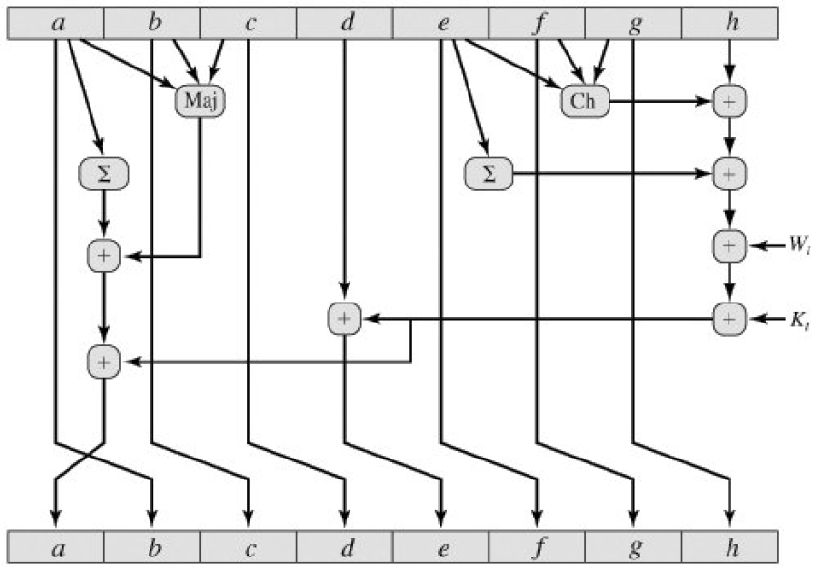

Source: Cryptography and Network Security by William Stallings
256 Bits

